Slide 1
Java Capstone Project Smart House Simulation: Energy Supply and Consumption System
A Simulation System for Managing Energy Supply and Consumption in Smart Houses

Slide 2
Group 7.2
Junaid Ahmad
Enrolment Number: 7222074 Professor: Galyna Tabunshchyk

Slide 3
Smart House: Simulation of the Energy supply and consumption

Slide 4
Tasks
• Simulation of the Smart Objects
• Simulation of the Energy Sources
• Management system for the house consumption
• Design of the User Interface for the Managing Smart Objects
• Design of the User Interface for Managing Energy Sources

Slide 5
System Requirements
Hardware Requirements
•Processor: Dual-core processor (e.g., Intel Core i3 or AMD equivalent).
•RAM: 4 GB.
•Storage: 2 GB of free disk space (for Java Development Kit (JDK), Integrated Development Environment (IDE), and project files).
•Graphics: Basic integrated graphics (no special GPU needed for Java programs).
Software Requirements
Operating System: Windows, macOS
Java Development Kit (JDK)
Integrated Development Environment (IDE): IntelliJ IDEA, Eclipse, or NetBeans

Slide 6
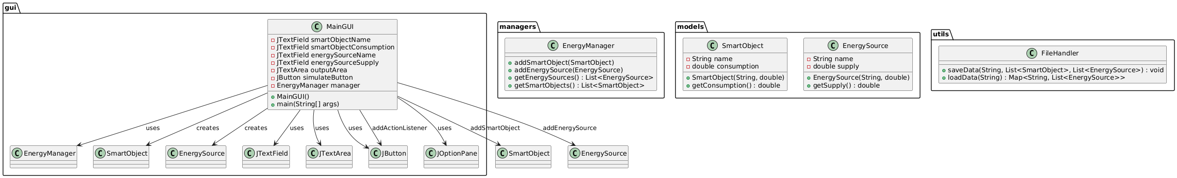
Class diagram

Slide 7
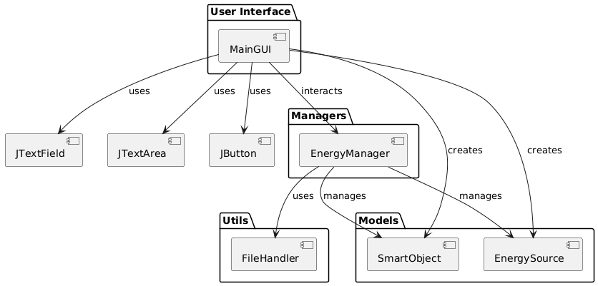
Component diagram

Slide 8
Management of I/O in the System
User Input:
Users input data (name and consumption/supply) for SmartObjects and EnergySources through the GUI.
System Output:
Simulation results are displayed in the outputArea of the GUI (Energy balance or deficit).
File I/O:
Settings (SmartObjects and EnergySources) are saved to settings

Slide 9
User Interfaces
Main GUI:
Smart Object Section: Users can input the name and consumption rate of smart objects.
Energy Source Section: Users can input the name and supply rate of energy sources.
Output Area: Displays the simulation results and logs.
Buttons:
Add Smart Object: Adds the smart object to the system.
Add Energy Source: Adds the energy source to the system.
Run Simulation: Calculates the total energy consumption and supply, then displays the results.

Slide 10
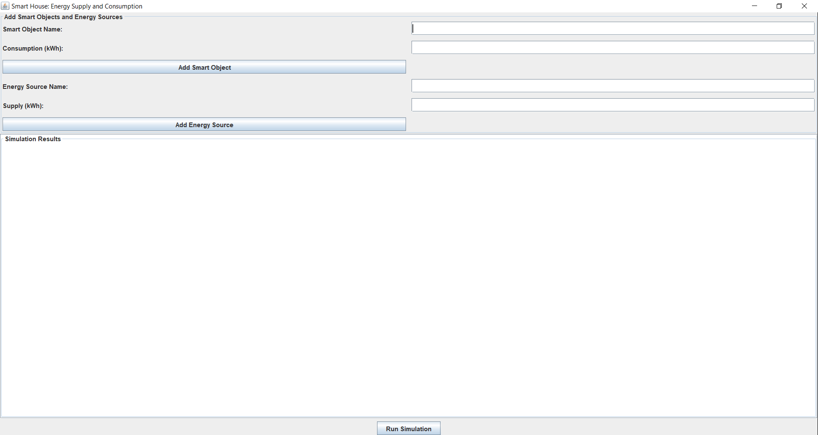

Slide 11
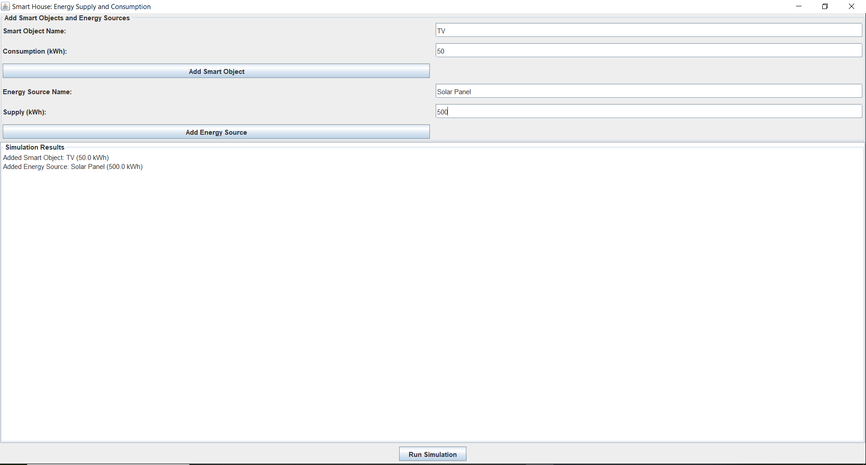

Slide 12
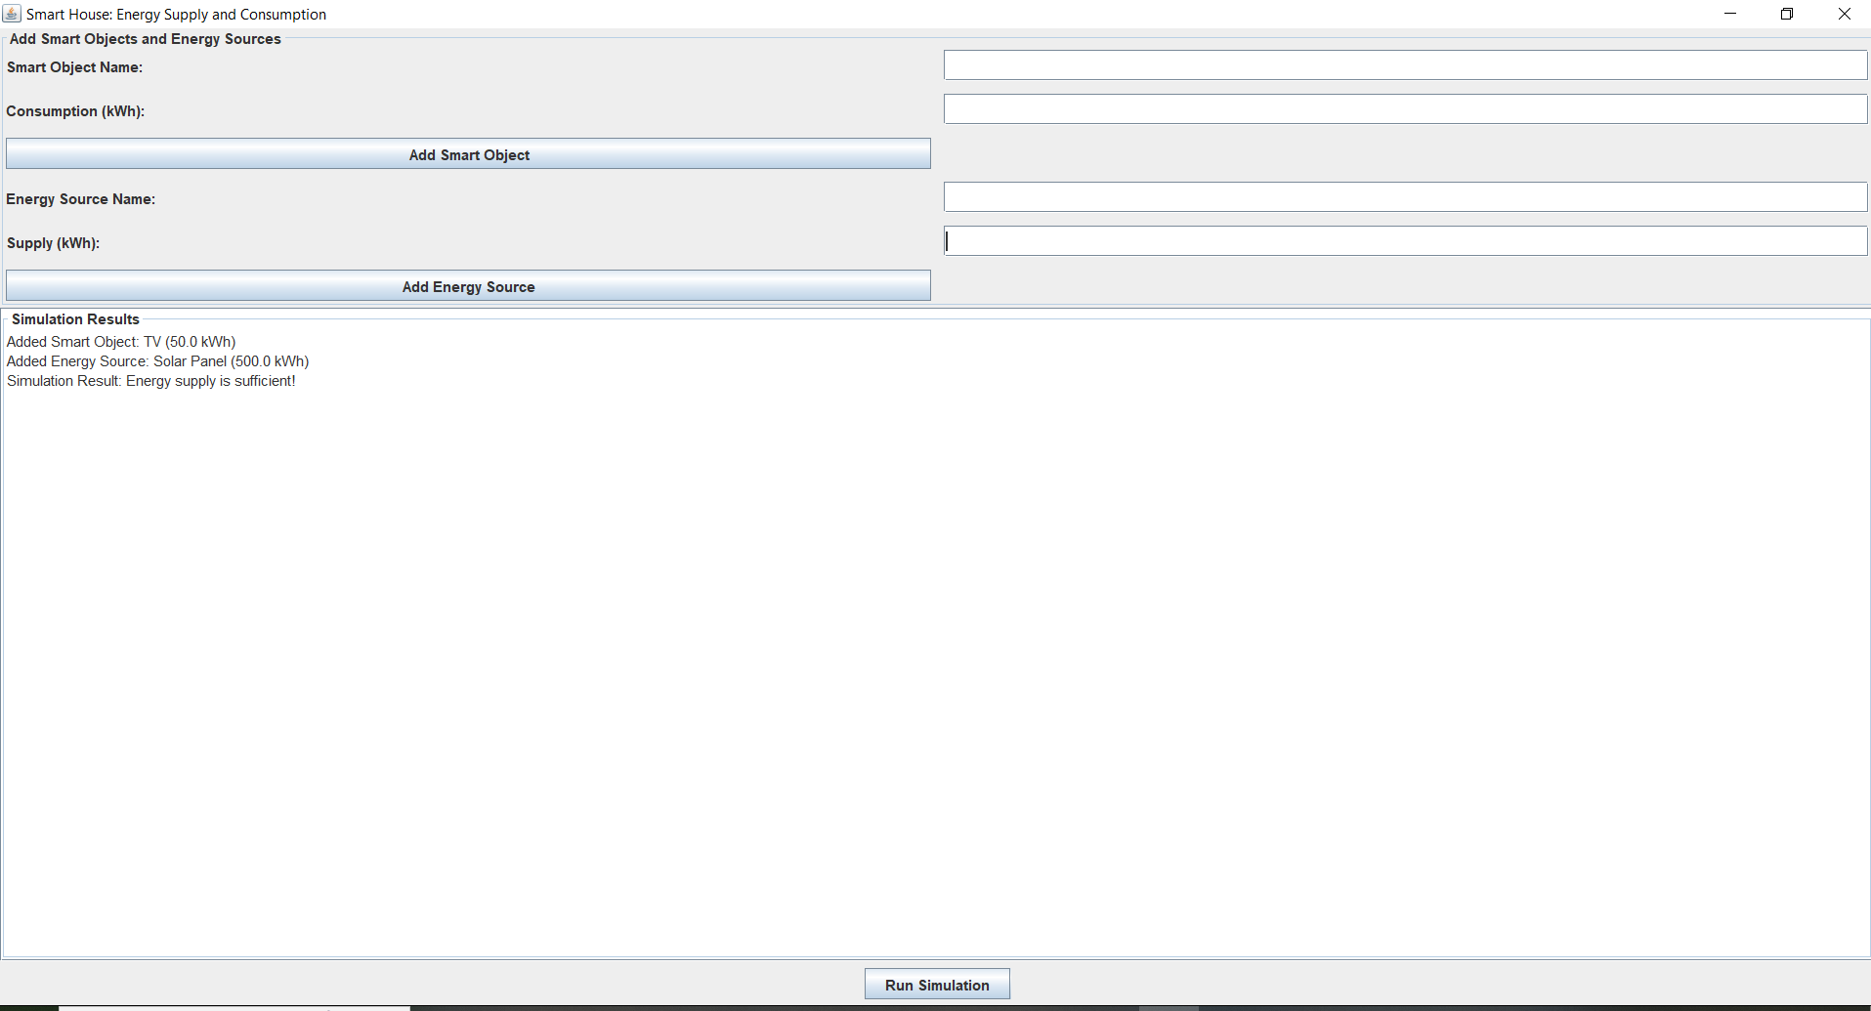

Slide 13
Concurrency
Single-threaded: The application is currently designed to run on a single thread, as it primarily handles user inputs and processes them sequentially.

Slide 14
Thank You!

Slide 15
Unit Tests
The EnergyManagerTest class contains unit tests to ensure the system functions correctly.
Test 1: testCalculateTotalConsumption()
Description: Verifies that the system correctly calculates the total energy consumption
by summing up the consumption rates of all smart objects.
Test Case: Added smart objects "TV" (50 kWh) and "Refrigerator" (200 kWh).
Expected Result: The total consumption should be 250 kWh.
Test 2: testCalculateTotalSupply()
Description: Verifies that the system correctly calculates the total energy supply by summing
up the supply rates of all energy sources.
Expected Result: The total supply should be 500 kWh.
Test Case: Added energy sources "Solar" (300 kWh) and "Grid" (200 kWh).

Slide 16
